Slide 1
Linux system administration
Day-2 done by
K.Shivani(CSE(aiml)
M.Lavanya(ECE-3b)
M.Vivek Reddy(ECE-3b)
M.Manideep(CSE-3b)
S.Chenna Rao(ECE-3c)

Slide 2

Linux system administration
A Linux admin, or Linux system administrator, is an IT professional who manages the functionality of a Linux system. Similar to iOS and Windows, Linux is an operating system that connects the internal hardware in electronics, including phones and computers.

Slide 3
Linux Commands
1. pwd Command
The PWD command is used to display the location of the current working directory.
Syntax:pwd
2. mkdir Command
The mkdir command is used to create a new directory under any directory.
Syntax:mkdir <directory name>

Slide 4
.
3. rmdir Command:The command is used to delete a directory.
Syntax:rmdir <directory name>
4. rm Command
The rm command is used to remove a file.
Syntax:
rm <file name>
5. ls Command
The ls command is used to display a list of content of a directory.

Slide 5
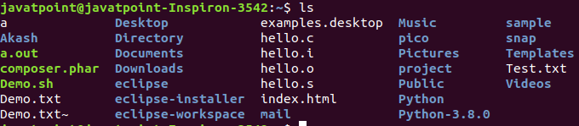
.
Syntax:
ls
_{6. cd Command}
The cd command is used to change the current directory.
_{Syntax:}
_{cd <directory name>}

Slide 6
Agile methodology
Day-3

Slide 7
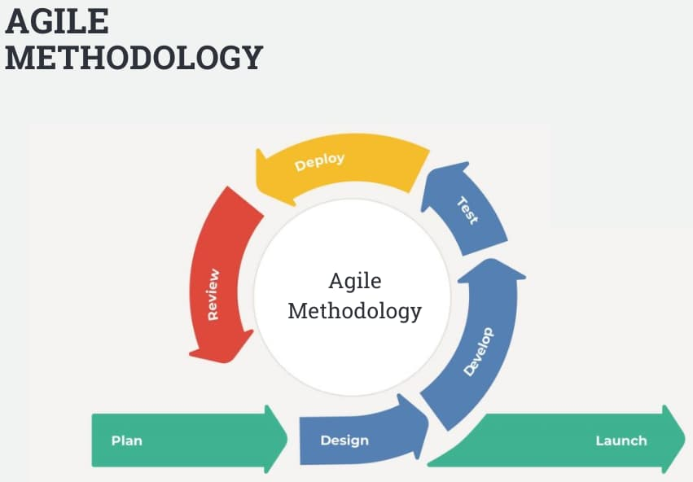
What is the Agile methodology?
The Agile methodology is a project management approach that involves breaking the project into phases and emphasizes continuous collaboration and improvement. Teams follow a cycle of planning, executing, and evaluating.

Slide 8
Principles of Agile Manifesto:- Principles of Agile Manifesto:- Principles of Agile Manifesto:- Principles of Agile Manifesto:- Principles of Agile Manifesto:- Principles of Agile Manifesto:-
Meeting end users' needs with early and Assembling a motivated team, providing them with the right environment and support, and trusting them.
Communicating face-to-face regularly continuous delivery of work.
Being open to changes in requirements even late in the project.
Delivering completed work at regular intervals, preferably short ones.
Working with the project team and business owners daily.
Using completed work to measure progress.

Slide 9
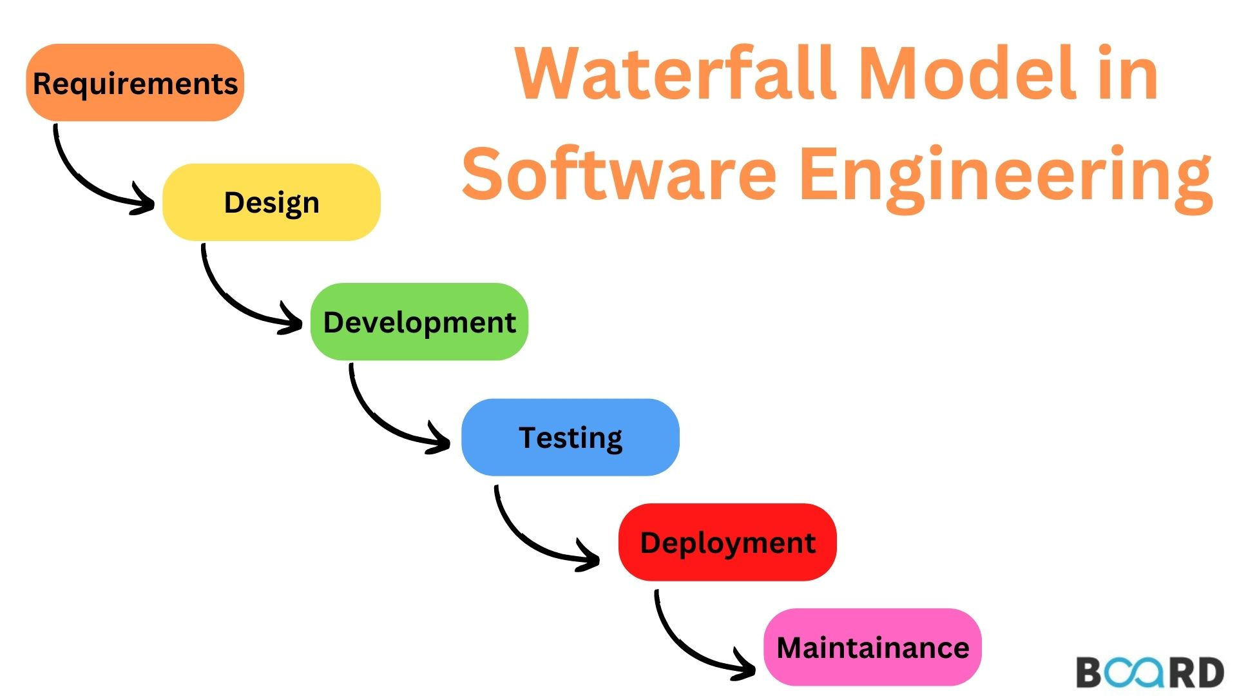
What is agile project management and how does it differ from traditional methods?
The easiest way to understand agile project management is by comparing it with traditional methods you’re probably already using.
One example is the waterfall method.
With this method, your team follows a sequential design process:

Slide 10
THANK YOU

